Slide 1
(TBD)
Market place
Project Definition
Team Members:
Emanuel Ben Hamo, Rotem Carmon, Vova Eygel

Slide 2
Highlights
Product Name: TBD
Product Short Description:
A marketplace for social media influencers and advertising campaigns.
Users:
Guest users, influencers, brand managers, Admin.
Key features:
Offer advertising campaigns by brands, chat between influencers and campaign managers,
Show influencers reviews & description.
Guest mode:
A guest can browse all current advertising campaigns offered by brands and look at specific influencer details, information & reviews.

Slide 3
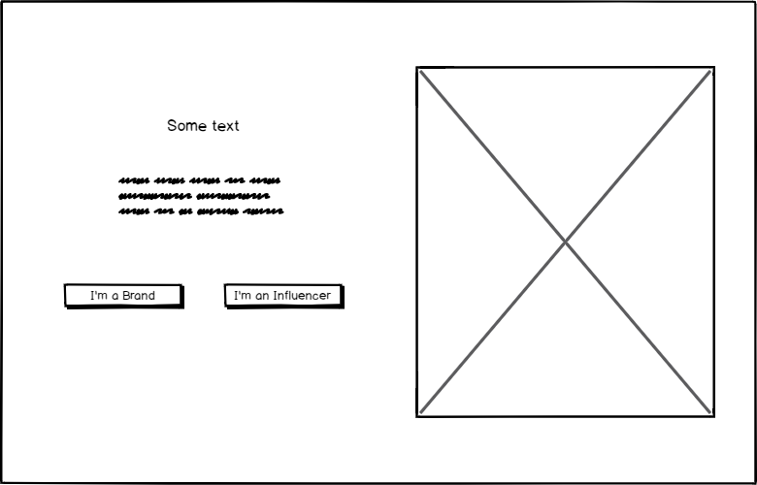
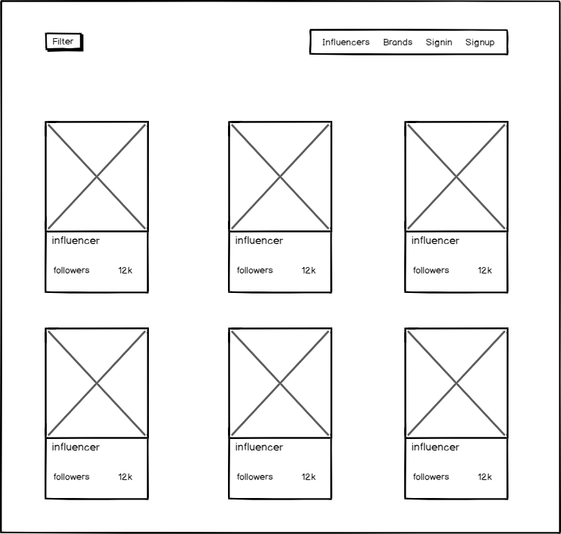
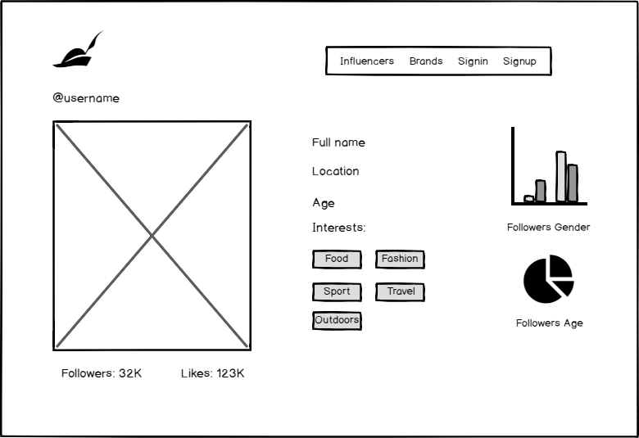
Main Pages
Home page
A short preview of the services available for social media influencers and advertising campaign managers.
Influencer list
View all influencers.
Influencer details
View the details of a selected influencer.

Slide 4
Main Flows
Home page
Influencer details
Influencer list
On clicking the “I’m a brand” button the app will redirect to the influencers list.
After selecting an influencer from the list the app will redirect to the influencer’s details page.
*Clicking the “I’m an influencer” button the app will redirect to the campaigns list.

Slide 5
Home page

Slide 6
Influencers/campaigns list
Main Pages UX

Slide 7
Influencers details
Main Pages UX

Slide 8
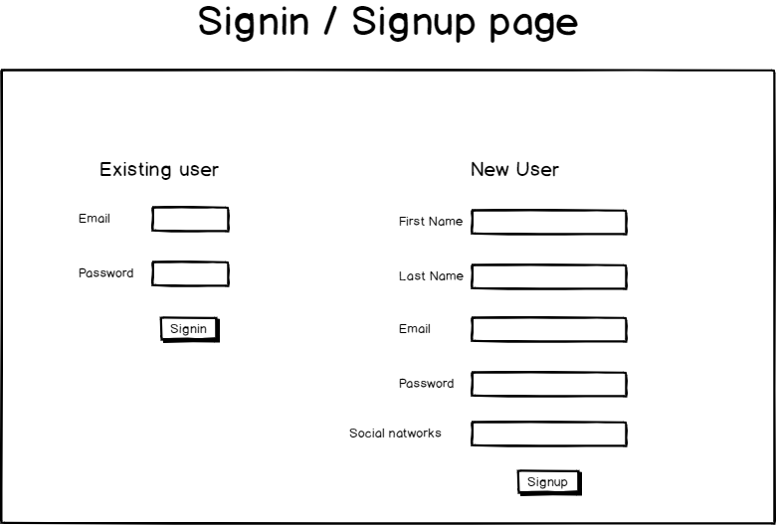
Main Pages UX

Slide 9
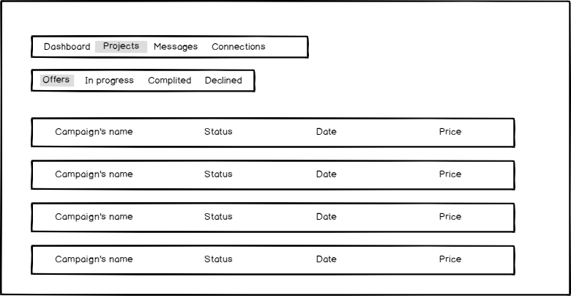
Back office

Slide 11
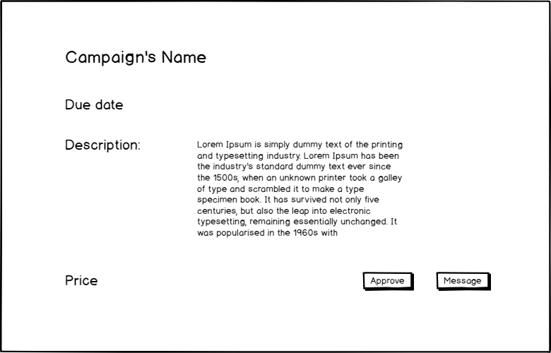
Campaign Details

Slide 12
Special Functionality for Demo
Guest mode auto login

Slide 13

Technical Design

Slide 14

Data Model

Slide 15
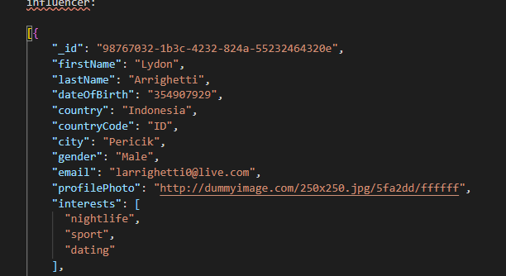
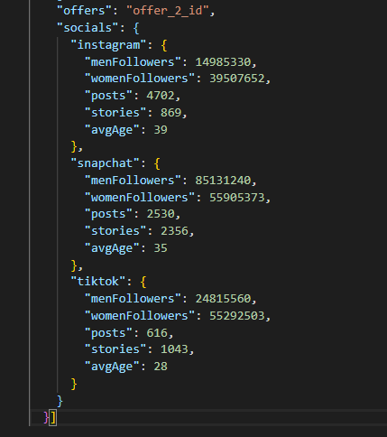
influencer

Slide 16
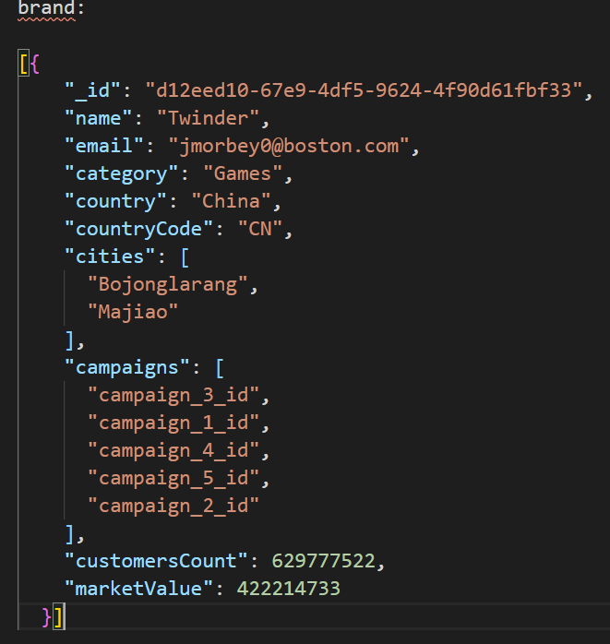
Brand

Slide 17
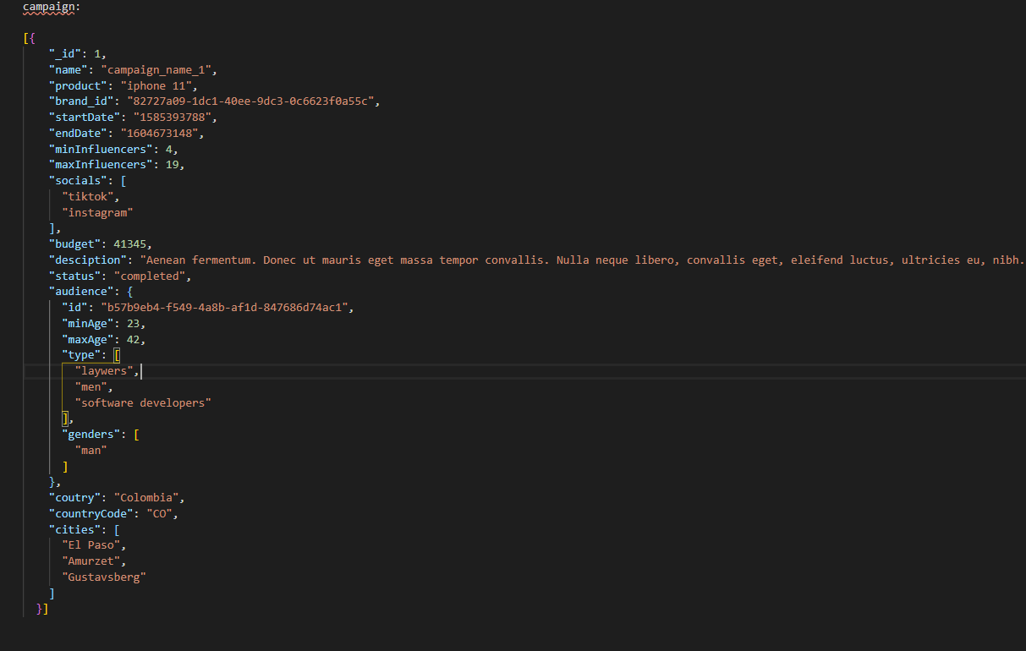
Campaign

Slide 18
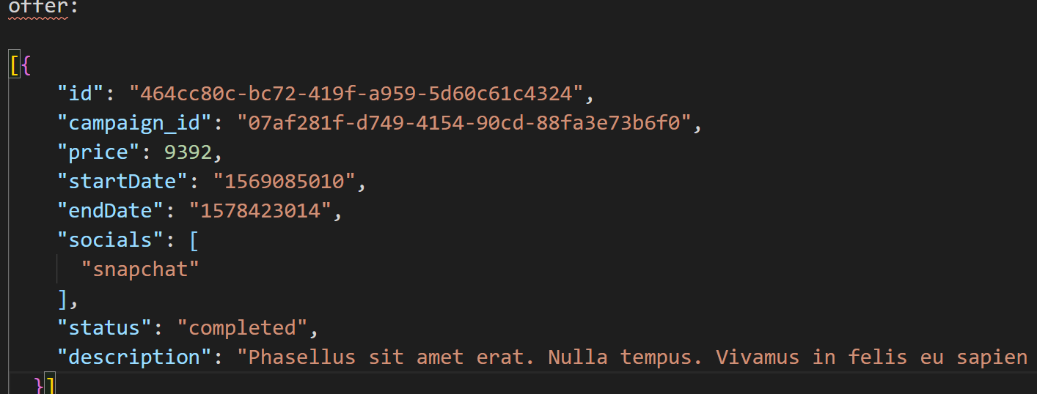
offer

Slide 19
Pages and Components
Pages and components

Slide 20
Store

Slide 21
Store - influencer
State:{
Campaigns:[],
currInfluencer:null,
}
getter:{
campaigns,
currInfluencer,
brands
}
Actions:{}

Slide 22
Pages and Components
Sockets

Slide 23
Socket Protocol
On
newChatMsg (msg)
Emit
sendMsg (msg)

Slide 24
Pages and Components

Slide 25
Pages
Page | Description | Routing
Homepage |  | /
marketPlace | Renders the relevant list component according to the user type. | /marketplace
influencerDetails | Shows details about an influencer. | /influencer/:id
brandDetails | Shows details about a brand | /brand/:id
LoginSignupPage | Login / Signup | /signup
backOffice | Back office page with a router view that renders a component relevent to the logged in user type. | /influencer/backOffice /brand/backOffice

Slide 26
Components
Component | Props | Emits | Description
List | Influencers/brands
influencerPreview | Influencer |  | Preview of the influencer with a link to his/her details page.
brandPreview | brand
offerPreview | offer
chat
filter
inbox
offers

Slide 27
Ajax and REST API
CRUDL for influencers and brands with axios and Node.js
Authentication
User/password and server session
Storage
Cloudinary to store users and profile images
Database
Mongodb on Atlas cloud databases
Web Sockets
Multi room with a Socket per station
Share
Share to Facebook (if time permits)

